Slide 1
Chapter 5
Host Objects:
Browsers and the DOM
WEB TECHNOLOGIES
A COMPUTER SCIENCE PERSPECTIVE
JEFFREY C. JACKSON

Slide 2
Overview
The Document Object Model (DOM) is an API that allows programs to interact with HTML (or XML) documents
  In typical browsers, the JavaScript version of the API is provided via the document host object
  W3C recommendations define standard DOM
Several other browser host objects are informal, de facto standards
  alert, prompt are examples
  Many others are covered in this chapter

Slide 3
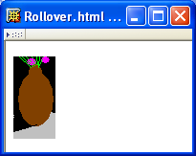
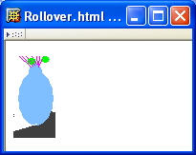
DOM Introduction
Example: “Rollover” effect
Cursor not over image
Image changes when cursor
moves over

Slide 4
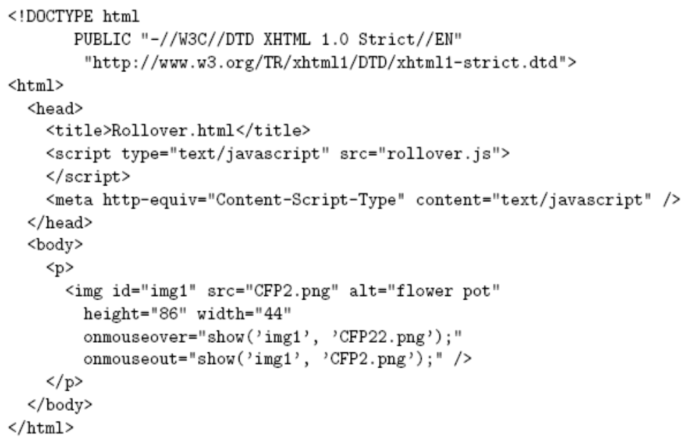
DOM Introduction

Slide 5
DOM Introduction
Import
JavaScript
code

Slide 6
DOM Introduction
Default language for scripts specified as attribute values

Slide 7
DOM Introduction
Calls to JavaScript
show() function when
mouse moves over/away
from image

Slide 8
DOM Introduction
Notice that id of image is first argument to show()

Slide 9
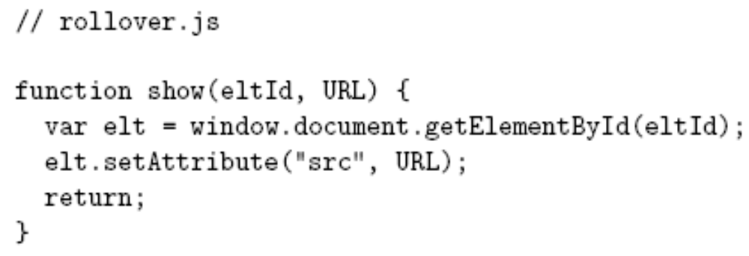
DOM Introduction

Slide 10
DOM Introduction
DOM method returning Object

Slide 11
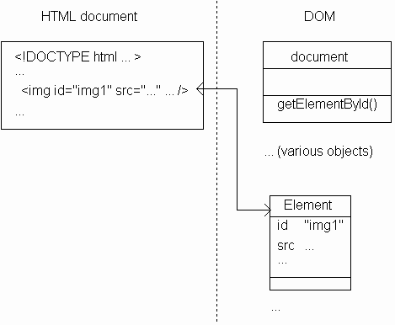
DOM Introduction
Returns instance
of Element
(DOM-defined
host object)
representing
HTML element
with given id

Slide 12
DOM Introduction
Some properties of
Element instance
correspond
to attributes of
HTML element

Slide 13
DOM Introduction
Method inherited by Element instances
for setting value of an attribute

Slide 14
DOM Introduction
Effect: src attribute of HTML element with
specified eltId is changed to specified URL

Slide 15
DOM Introduction
Image src changed to
CFP22.png when mouse
is over image,
CFP2.png when leaves

Slide 16
DOM History and Levels
Very simple DOM was part of Netscape 2.0
Starting with Netscape 4.0 and IE 4.0, browser DOM API’s diverged significantly
W3C responded quickly with DOM Level 1 (Oct 1998) and subsequently DOM Level 2
This chapter: JavaScript API for DOM2 + some coverage of browser specifics

Slide 17
Intrinsic Event Handling
An event is an occurrence of something potentially interesting to a script:
  Ex: mouseover and mouseout events
An HTML intrinsic event attribute is used to specify a script to be called when an event occurs
  Ex: onmouseover
  Name of attribute is on followed by event name

Slide 18
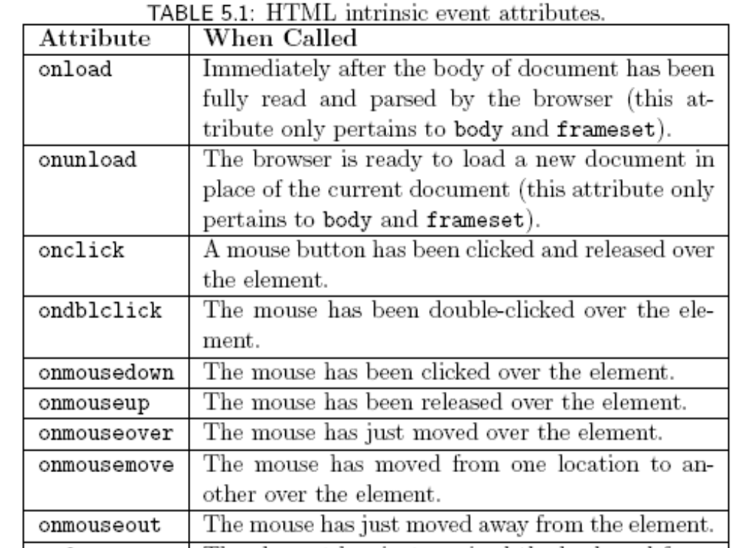
Intrinsic Event Handling

Slide 19
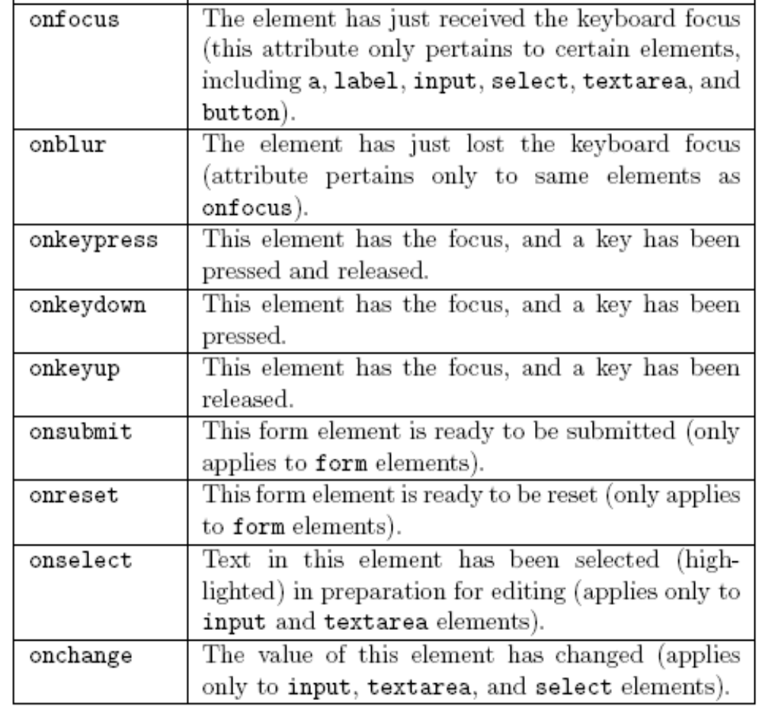
Intrinsic Event Handling

Slide 20
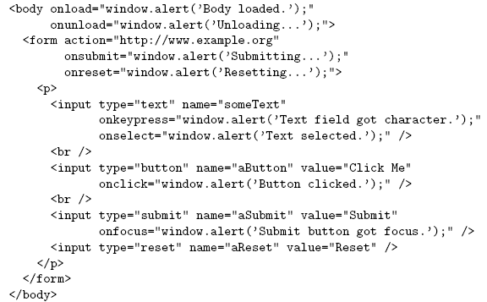
Intrinsic Event Handling

Slide 21
Intrinsic Event Handling
Intrinsic event attribute value is a script; what language is it written in?
HTTP Content-Script-Type header field specifies default scripting language
meta element allows document to specify values as if they were header fields
Header field name
Header field value

Slide 22
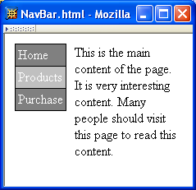
Modifying Element Style
Change
background color
of element
containing cursor

Slide 23
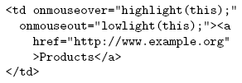
Modifying Element Style

Slide 24
Modifying Element Style
Like rollover, style needs to be modified
both when entering and exiting the element.

Slide 25
Modifying Element Style
Reference to Element instance
representing the td element

Slide 26
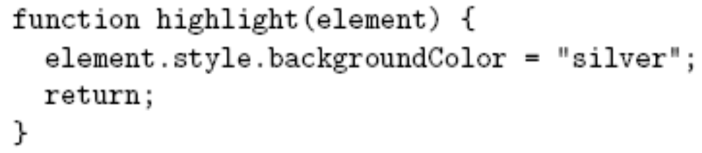
Modifying Element Style

Slide 27
Modifying Element Style
Reference to Element instance

Slide 28
Modifying Element Style
All Element instances have a style property
with an Object value

Slide 29
Modifying Element Style
Properties of style object
correspond to CSS style properties of
the corresponding HTML element.

Slide 30
Modifying Element Style
Rules for forming style property names from names of CSS style properties:
  If the CSS property name contains no hyphens, then the style object’s property name is the same
    Ex: color color
  Otherwise, all hyphens are removed and the letters that immediately followed hyphens are capitalized
    Ex: background-color backgroundColor

Slide 31
Modifying Element Style
Net effect: “silver” becomes the specified value for
CSS background-color property of td element;
browser immediately modifies the window.

Slide 32
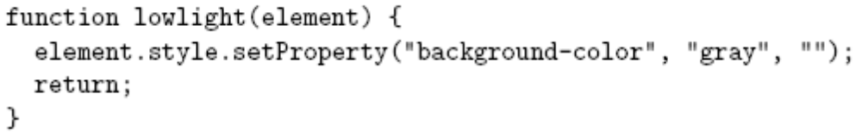
Modifying Element Style
Alternative syntax (not supported in IE6):

Slide 33
Modifying Element Style
Alternate syntax (not supported in IE6):
Every DOM2-compliant style object
has a setProperty() method

Slide 34
Modifying Element Style
Alternate syntax (not supported in IE6):
CSS property
value
CSS property
name
(unmodified)
Empty string
or
“important”

Slide 35
Modifying Element Style
Advantages of setProperty() syntax:
  Makes it clear that a CSS property is being set rather than merely a property of the style object
  Allows CSS property names to be used as-is rather than requiring modification (which can potentially cause confusion)

Slide 36
Modifying Element Style
Obtaining specified CSS property value:
Alternate DOM2 syntax (not supported by IE6):

Slide 37
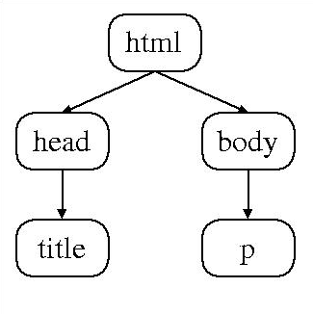
Document Tree
Recall that HTML document elements form a tree structure, e.g.,
DOM allows scripts to access and modify the document tree

Slide 38
Document Tree: Node
There are many types of nodes in the DOM document tree, representing elements, text, comments, the document type declaration, etc.
Every Object in the DOM document tree has properties and methods defined by the Node host object

Slide 39
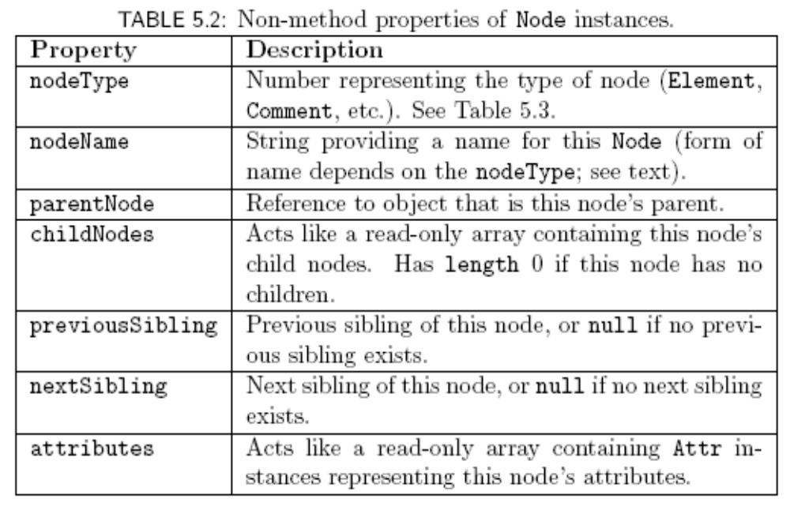
Document Tree: Node

Slide 40
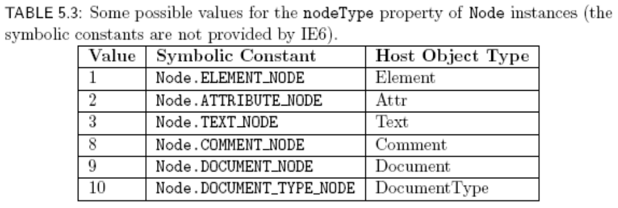
Document Tree: Node

Slide 41
Document Tree: Node

Slide 42
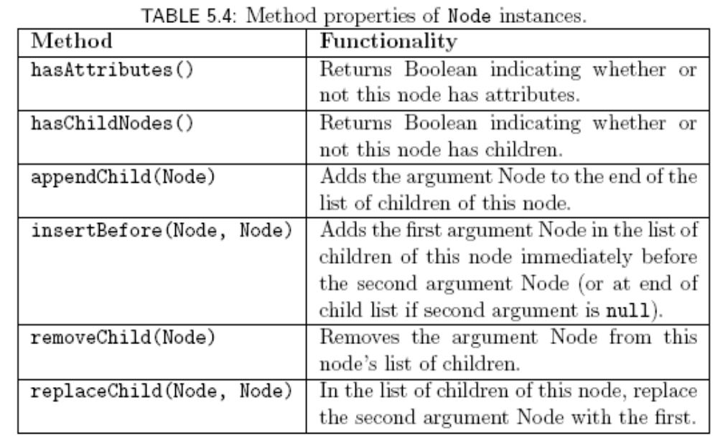
Document Tree: Node

Slide 43
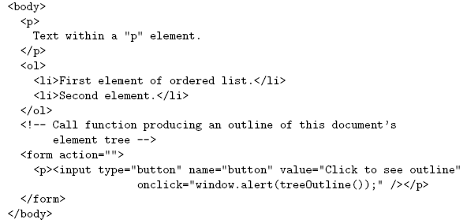
Document Tree: Node
Example HTML document
Function we will write that will
use Node methods and properties
to produce string representing
Element tree

Slide 44
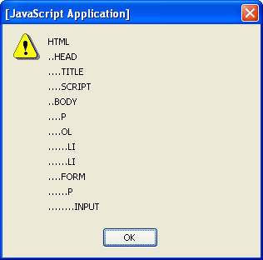
Document Tree: Node
String produced by TreeOutline():

Slide 45
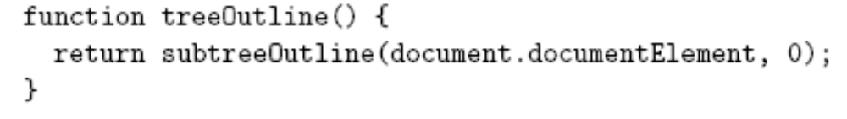
Document Tree: Node
Example: “walking” the tree of an HTML document
  Reference to html element is contained in documentElement property of document object
  Use Node-defined methods to recursively create an outline of nodeName’s:
Depth in tree

Slide 46
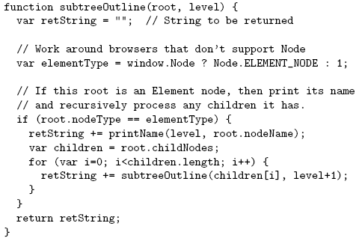
Document Tree: Node

Slide 47
Document Tree: Node
Contains nodeType value representing Element

Slide 48
DOM Event Handling
Note: IE6 has a different event model
Event instance created for each event
Event instance properties:
  type: name of event (click, mouseover, etc.)
  target: Node corresponding to document element that generated the event (e.g., button element for click, img for mouseover). This is the event target.

Slide 49
DOM Event Handling
JavaScript event listener: function that is called with Event instance when a certain event occurs
An event listener is associated with a target element by calling addEventListener() on the element

Slide 50
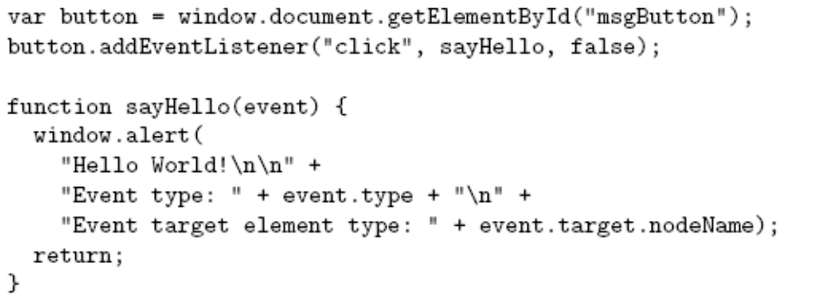
DOM Event Handling

Slide 51
DOM Event Handling
Event
target

Slide 52
DOM Event Handling
Event type

Slide 53
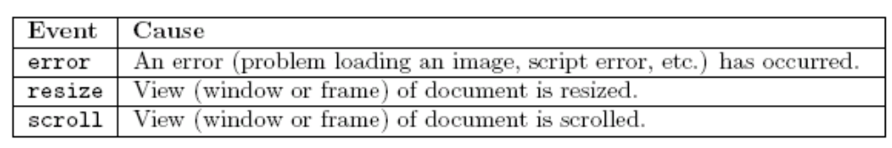
DOM Event Handling
DOM event types:
  All HTML intrinsic events except keypress, keydown, keyup, and dblclick
  Also has some others that are typically targeted at the window object:

Slide 54
DOM Event Handling
Event handler
Definition
of event
handler

Slide 55
DOM Event Handling
Event instance

Slide 56
DOM Event Handling
Normally false
(more later)

Slide 57
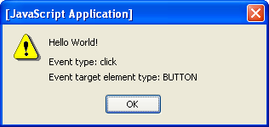
DOM Event Handling

Slide 58
DOM Event Handling:
Mouse Events
DOM2 mouse events
  click
  mousedown
  mouseup
  mousemove
  mouseover
  mouseout
Event instances have additional properties for mouse events

Slide 59
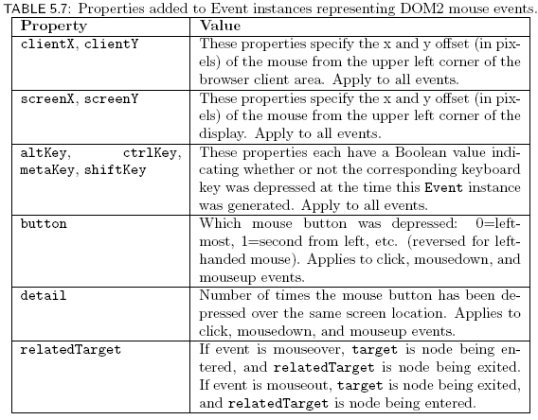
DOM Event Handling:
Mouse Events

Slide 60
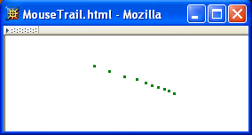
DOM Event Handling:
Mouse Events
Example: mouse “trail”

